Slide 1
Advanced Database System Non-Redundant Dynamic Fragment Allocation with Horizontal Partition in Distributed Database System
Under guidance of:
By:
Hanumant Mule
1
Notes:
1

Slide 2
Abstract
The aim of a fragment allocation algorithm is to determine which fragment is properly located to which sites so as to minimize the total data transfer cost and reduce the executed time of queries.
Dynamic fragment allocation technique provides many environments where access patterns of different sites from multiple locations made to fragment change over time.
The proposed approach reallocates fragments with respect to the access patterns made to each fragments with amount of data volume up to time constraint and threshold value.
The write data volume has to be considered for relocation process when more than one site simultaneously qualifies for the fragment.
2
Notes:
2

Slide 3

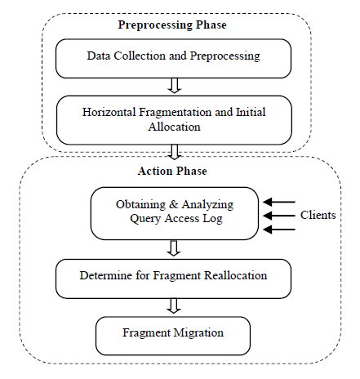
Implementation Methodologies
The proposed algorithm can be considered into two phases:
Preprocessing phase and
Action phase

Slide 4
Implementation Methodologies(Contd.)
Data Collection and Preprocessing
Assumption: There is a fully connected network consisting of many different sites
S= {s1, s2, s3, ..., sn}.
Specify Access threshold value and time constraint
Each site stores log information table. The structure of log information table is Log_Info (AFID, ASID, ADateTime, RorWA, DataVol)
AFID means ID of the fragment which is accessed,
ASID means ID of the site which accesses the fragment,
ADateTime means date and time of fragment access from respectively accessing site,
RorWA means read or write of fragment access
DataVol means volume of read data transmitted to and from the accessed fragment or volume of updated data.

Slide 5
Implementation Methodologies(Contd.)
Horizontal Fragmentation and Initial Allocation
Fj = σ Qj(R), where 1≤ j≤ i , Where
Qj is the selection conditions as a simple predicate and
i is the maximum number of fragments.
Suppose that there are F fragments of global relation R and S sites in the distributed database system.
All the small fragments of global relation are initially allocated over different sites using any static allocation method in non-redundant manner.
Each site contains at least one fragment.

Slide 6
Implementation Methodologies(Contd.)
Obtaining and Analyzing Query Access Log
Log_Info at each site Sy is written every time when each fragment at owner site is accessed from different sites Xx where y= 1,2,3,... ,S , x= 1,2,3,... ,S, and y = x or x≠ y.
Step 1: Write a log record Azy in Log_Info table at site sy.
Step 2: If the ID of local site Sy is the same as the ID of the site in the log record Azy (x=y) that means local access is made, then do nothing.
Otherwise (x≠y) that means remote access is made, and then go to the following next process.

Slide 7
Implementation Methodologies(Contd.)
Determine Fragment Reallocation and Fragment Migration
Outcome – Select the site which has maximum average data volume access to fragment.
Algorithm
Step 1: Calculate the total number of read and write accesses between the fragment Fi and each remote site Sx that made access to the fragment respectively ,
If Fi(Njx < access threshold ), then do nothing, otherwise go to the following step.
Step 2: Calculate the average volume of read and write data transmitted between fragment Fi and all the sites (including local site Sy) that made access to the fragment Fi.
Step 3: Calculate the average volume of read and write data transmitted of each accessing remote site.
If Step 3 result < Step 2 result , Then do nothing.
Else go to next step

Slide 8
Implementation Methodologies(Contd.)
Step 4: If there is only one accessing remote site Sx qualify constraints stated in Step 3
Then, Reallocate fragment fi to remote site Sx and remove from the current site Sy,
Update Fragment Allocation Information matrix.
Step 5: If more than one sites qualify constraints stated in step 3 Then,
Calculate the volume of write data transmitted between the fragment Fi and all qualified remote sites within time interval.
Finally select the site which has maximum write data volume than other sites.
Reallocate the fragment to that site and update the allocation information matrix.

Slide 9
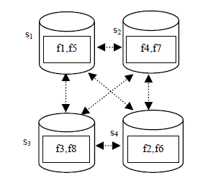
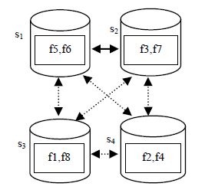
Example
Fragment Reallocation
Fragment reallocated over different sites
Fragment initially allocated over different sites

Slide 10
Thank You

